Slide 1
Attendance Forecasting for LA Clippers’ 2019/20 Season
By: Suhas Sridhar

Slide 2
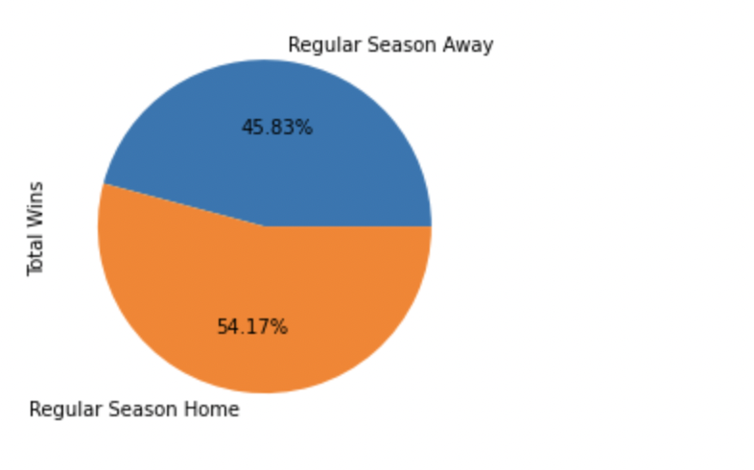
Exploratory Data Analysis & Insights
The Clippers have some Home game advantage!

Slide 3
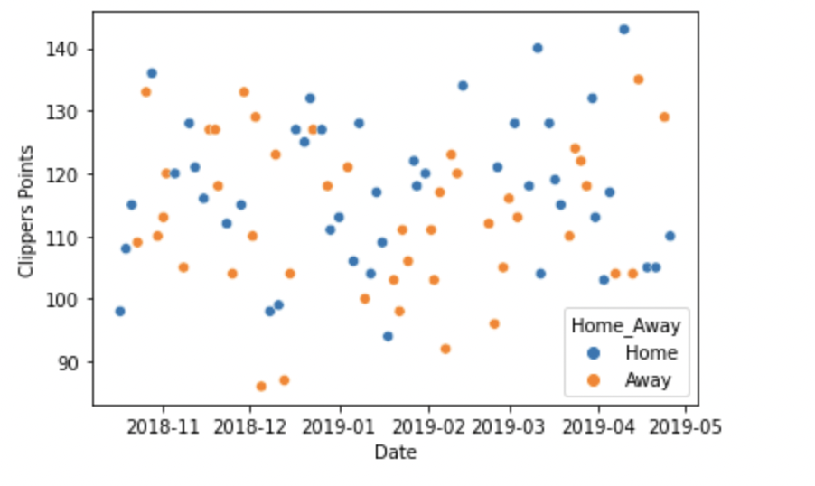
Exploratory Data Analysis & Insights

Slide 4
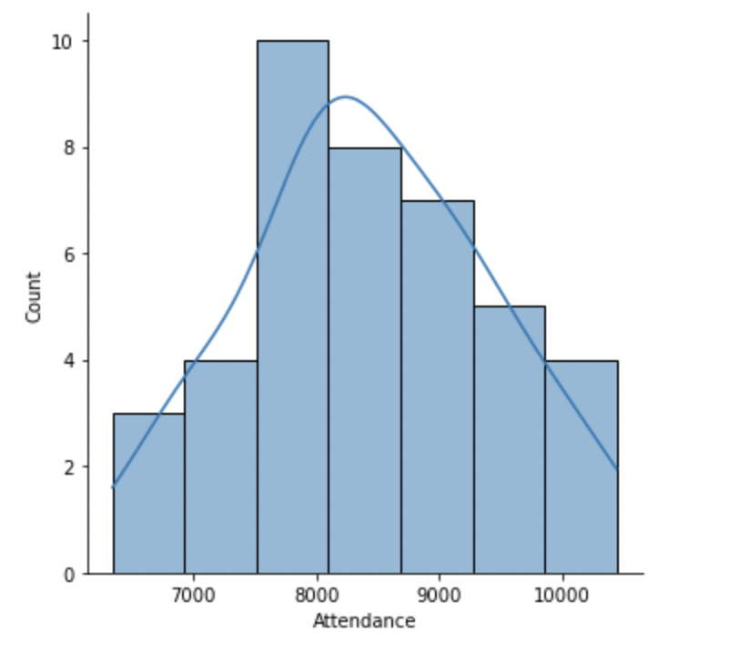
What’s the distribution of attendance?
Scan Data is available only for the 41 Home games!

Slide 5
Predict Next Season attendance
Model: Random Forest
Why this Model?
Considered as a highly accurate and robust method because of the number of decision trees participating in the process
It does not suffer from the overfitting problem
You can get the relative feature importance

Slide 6
Why this Approach?
Random forest method handles Bias well! Since only home game data is available, the Bias associated with home advantage can be handled by this model
If I were to incorporate outside data, I would take the playoff game data, and take the next season’s fixtures
Compared results of this model with Linear regression model. Received better accuracy in Random forest

Slide 7
Feature Engineering
Weekend Binary – Whether the game took place in the weekend. 1 if Yes, 0 if No
Overtime Binary – Whether the game went into overtime. 1 if Yes, 0 if No
Result Binary – Whether the Clippers won the game. 1 if Yes, 0 if No
Streak Numeric – Numeric value of the streak score. A 4-win streak is +4 while a 3-loss streak is -3
Binary variable for each opponent – Whether the Clippers played a particular opponent or not.

Slide 8
Feature Engineering
Game Binary – Whether the game was a regular season game or a Playoff.
Although our table has only Regular season Home games, this model can also accommodate data if the attendance records for Playoff games were made available.

Slide 9
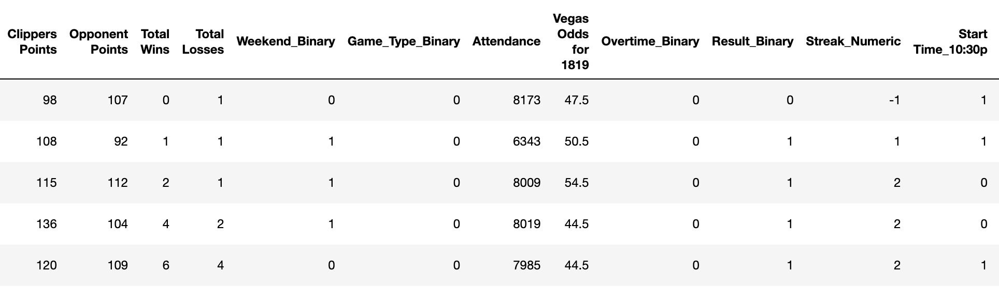
Features Used

Slide 10
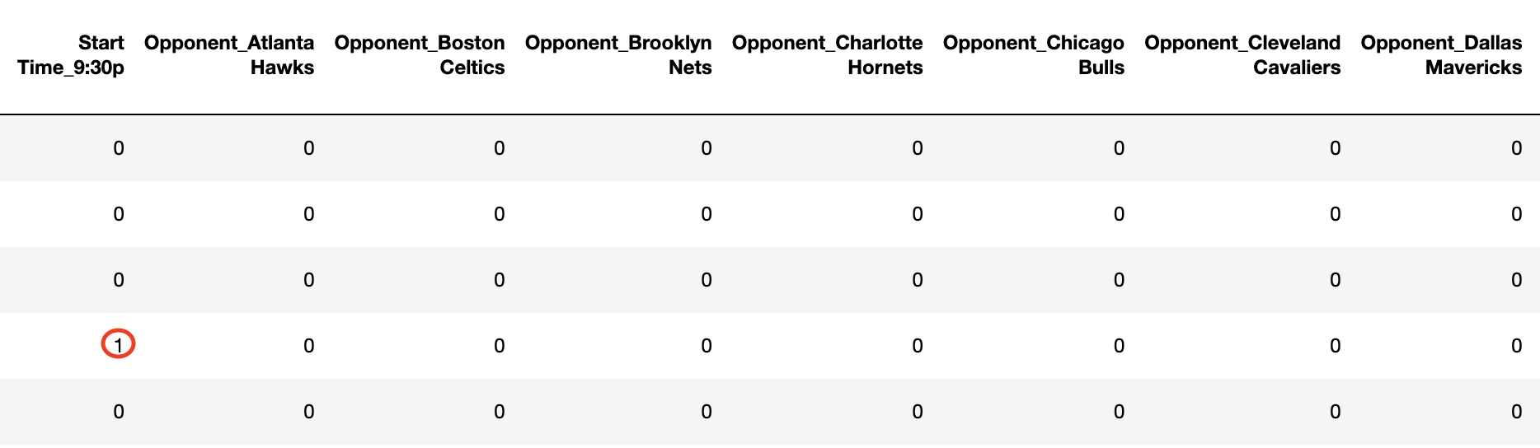
Features Used

Slide 11
Features Used
I did not use Clippers points & opponent’s points as a feature in the model!
Models use features to predict a variable.
We do not have the points score for the upcoming season, as I assumed the games have not taken place yet!
Best we can do is to predict the scores. We can feed these predicted scores into the model. The model will then use these predicted scores to further predict the attendance.
This doesn’t sound right! Hence the decision to not use points as a feature in the model

Slide 12
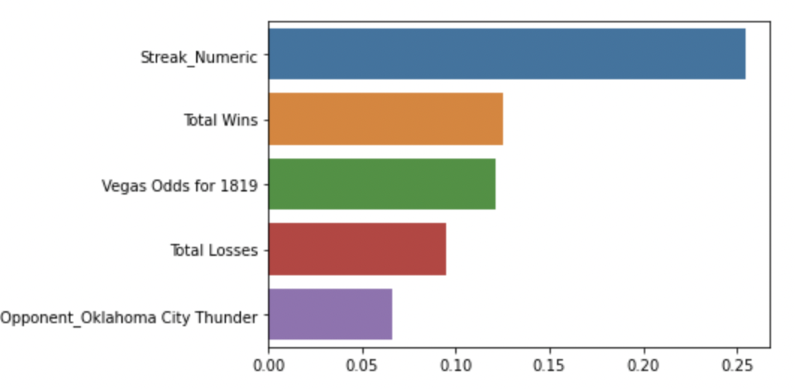
Important features according to the model

Slide 13
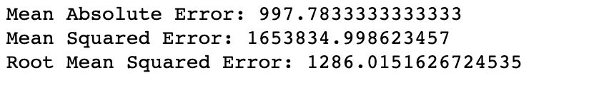
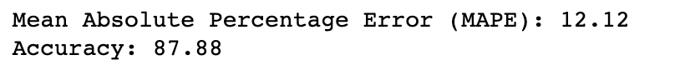
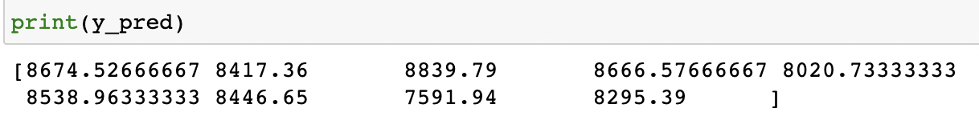
The results

Slide 14
Limitations
Data generating Process – Only 41 home games’ data is available
Playoff home game data not available! Playoff games have higher attendance
Lack of Domain Expertise. Domain expertise can help build more accurate models.
Random forests is slow in generating predictions because it has multiple decision trees.
The model is difficult to interpret compared to a decision tree, where you can easily make a decision by following the path in the tree.

Slide 15
THANK YOU!

Slide 16
Appendix

Slide 17
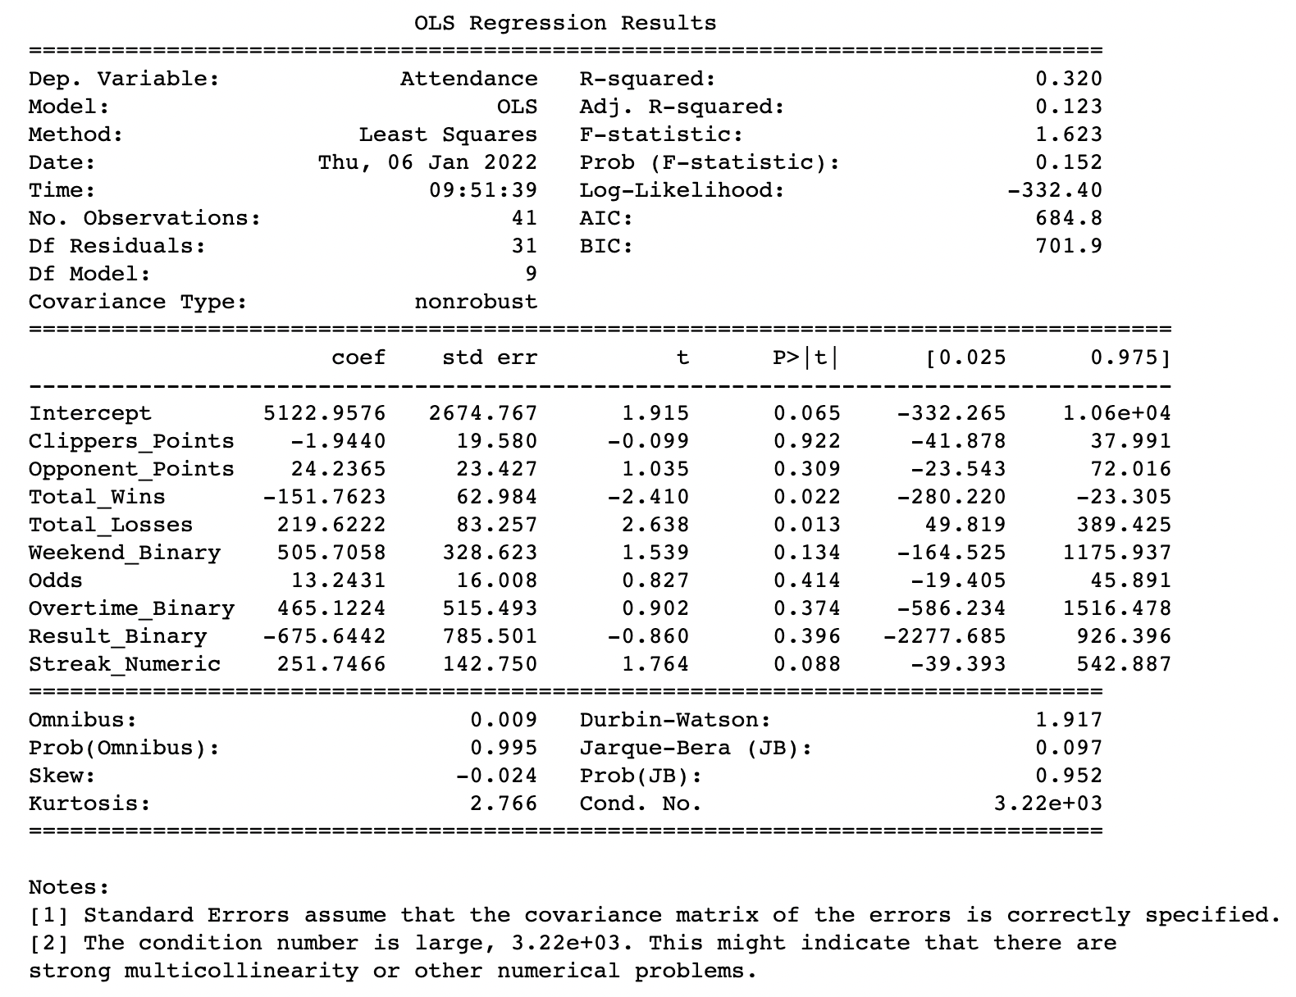
Linear Regression Model -1

Slide 18
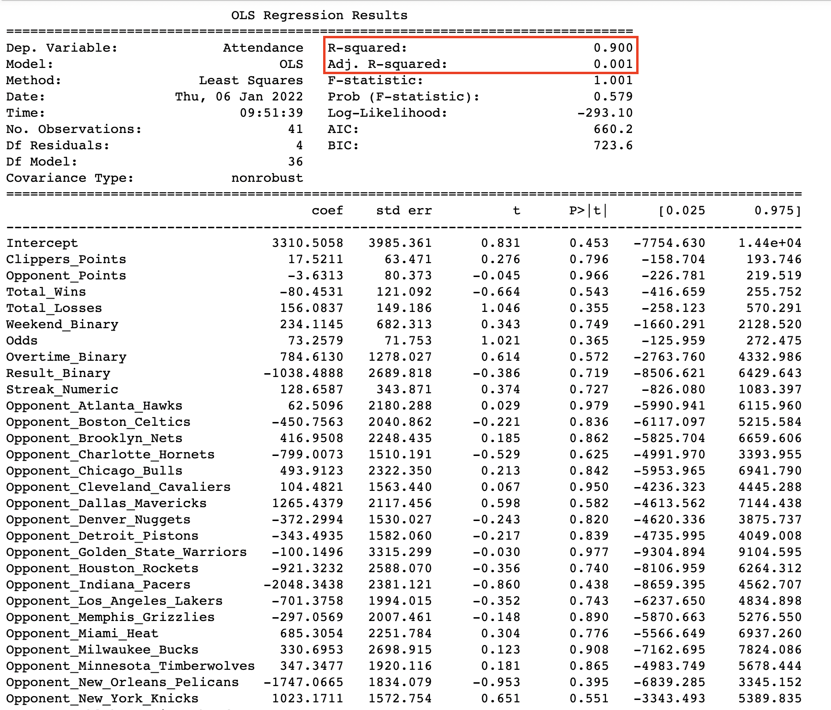
Linear Regression Model-2

Slide 19
How does Random Forest work?
Select random samples from a given dataset.
Construct a decision tree for each sample and get a prediction result from each decision tree.
Perform a vote for each predicted result.
Select the prediction result with the most votes as the final prediction.

Slide 20
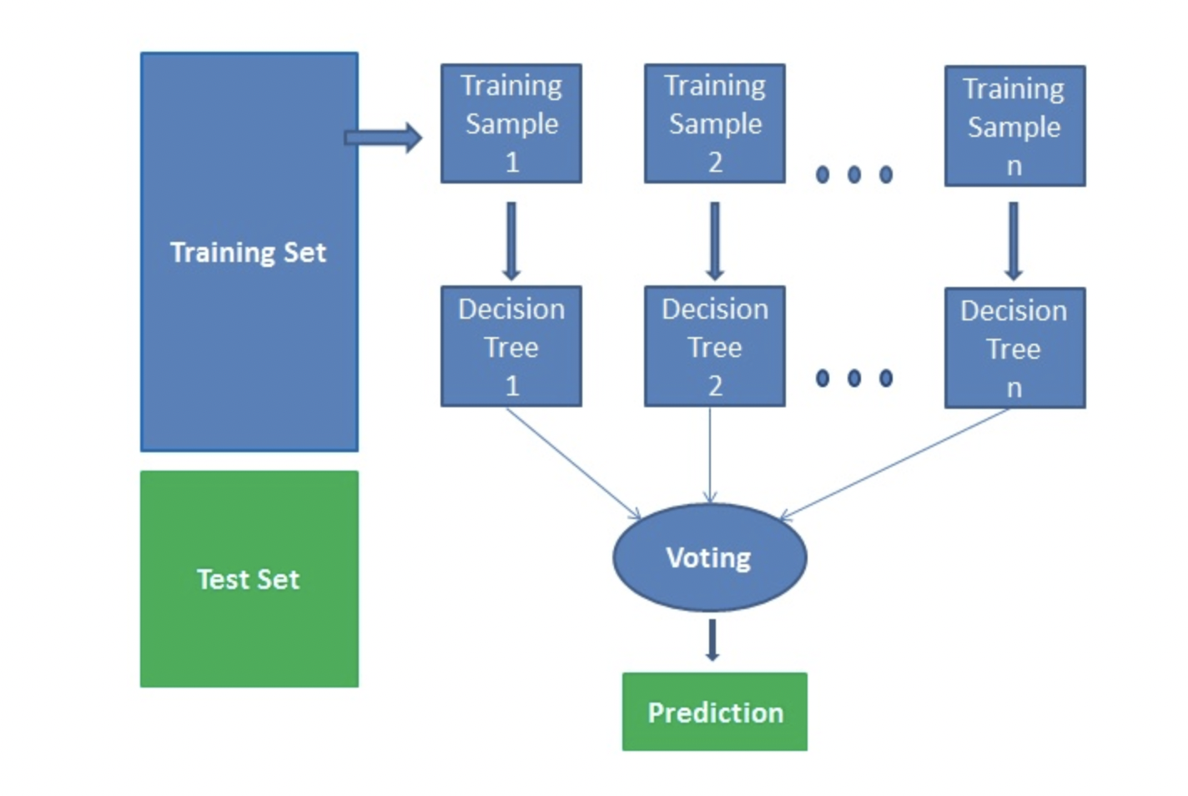
How does Random Forest work?

Slide 21
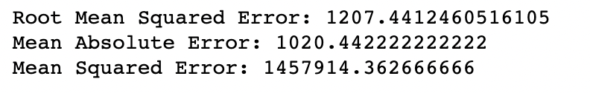
Random Forest Initial Model with Game points included

Slide 22
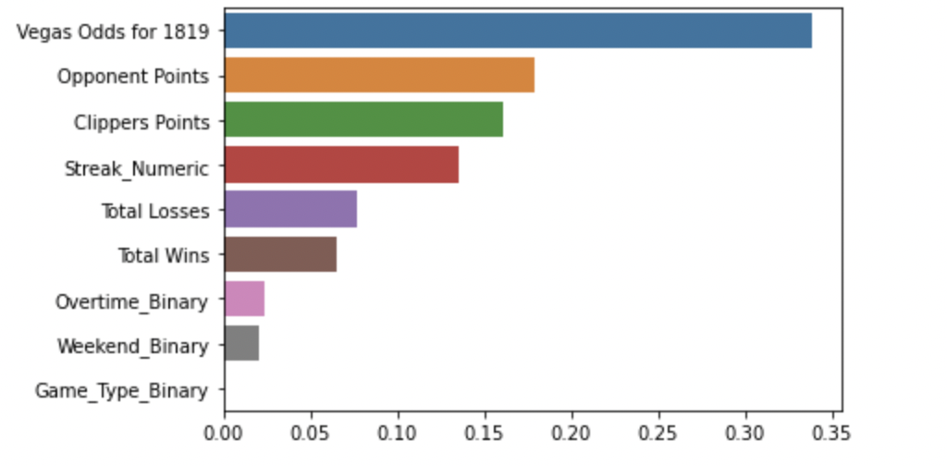
Random Forest Initial Model with Game points included

